Slide 2
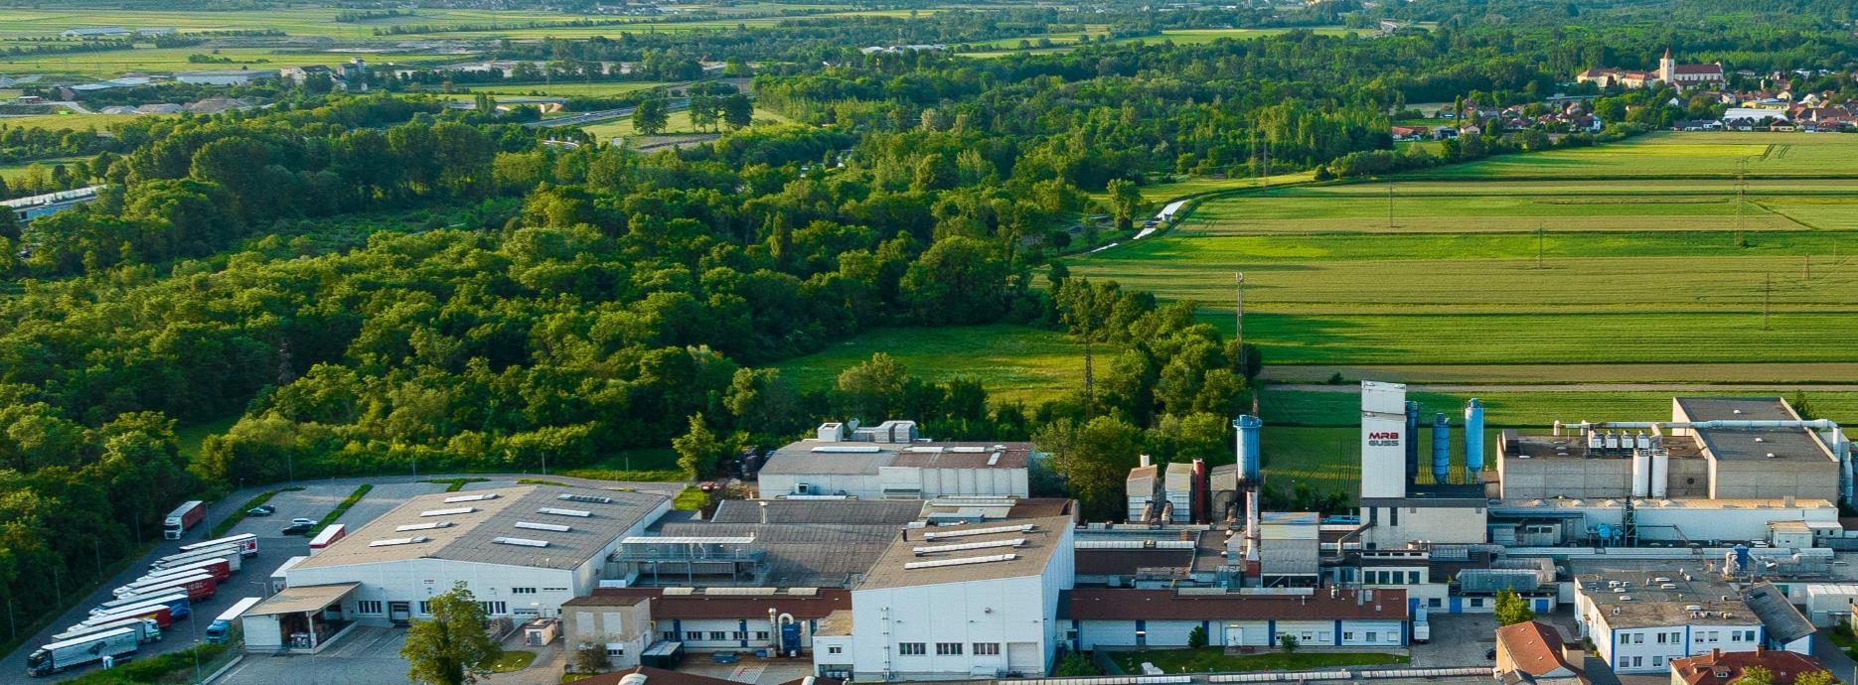
Overview
220 employees
Turnover 2025: 62 Mio. EUR
Capacity: 1m moulds p.a.

Slide 3
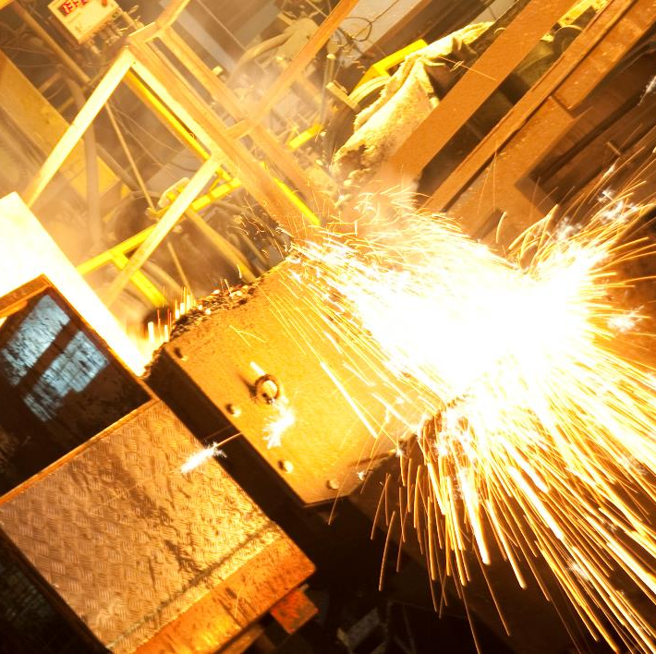
Iron Casting by Experience
  More than 100 years of experience
  Quickness and high flexibility for our customers
  State of the art technology
  High value-added chain
  Wide range of iron casting materials

Slide 4
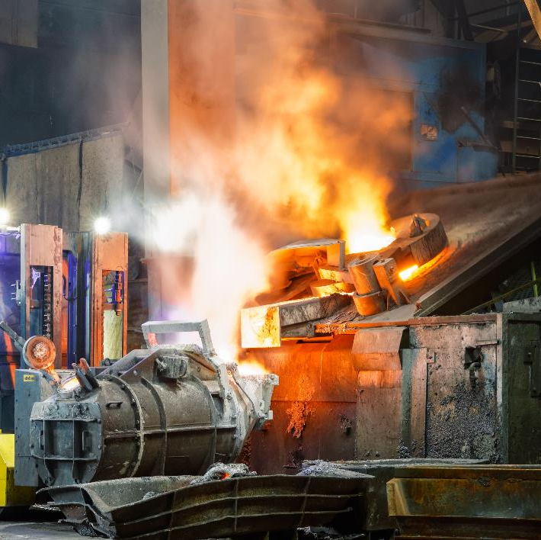
Service portfolio
  From low volume Series up to high volume of 1.000.000 pcs/year
  Part weights from 0,5 kg to 35 kg per piece with maximum dimensions of 700 mm x 500 mm
  Specific expertise for complex parts with multiple cores and parts for high temperature applications
  Production of prototypes identical to serial production within short time

Slide 5
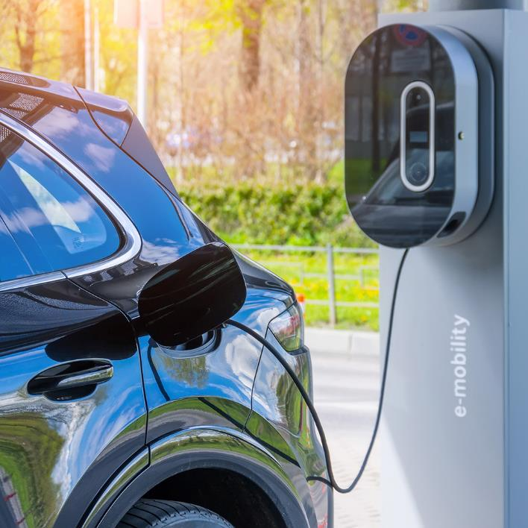
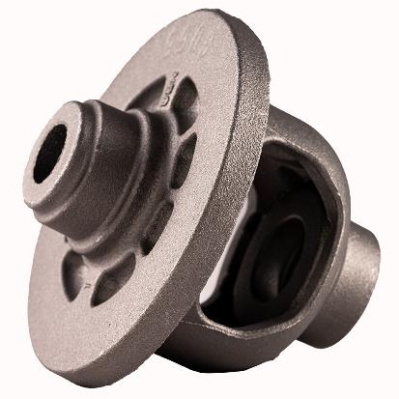
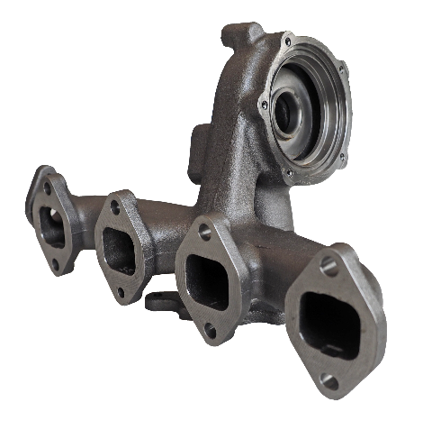
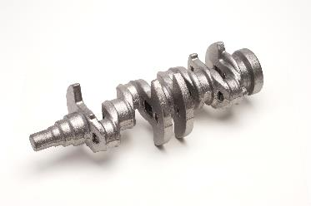
Castings for Passenger Cars

Slide 6
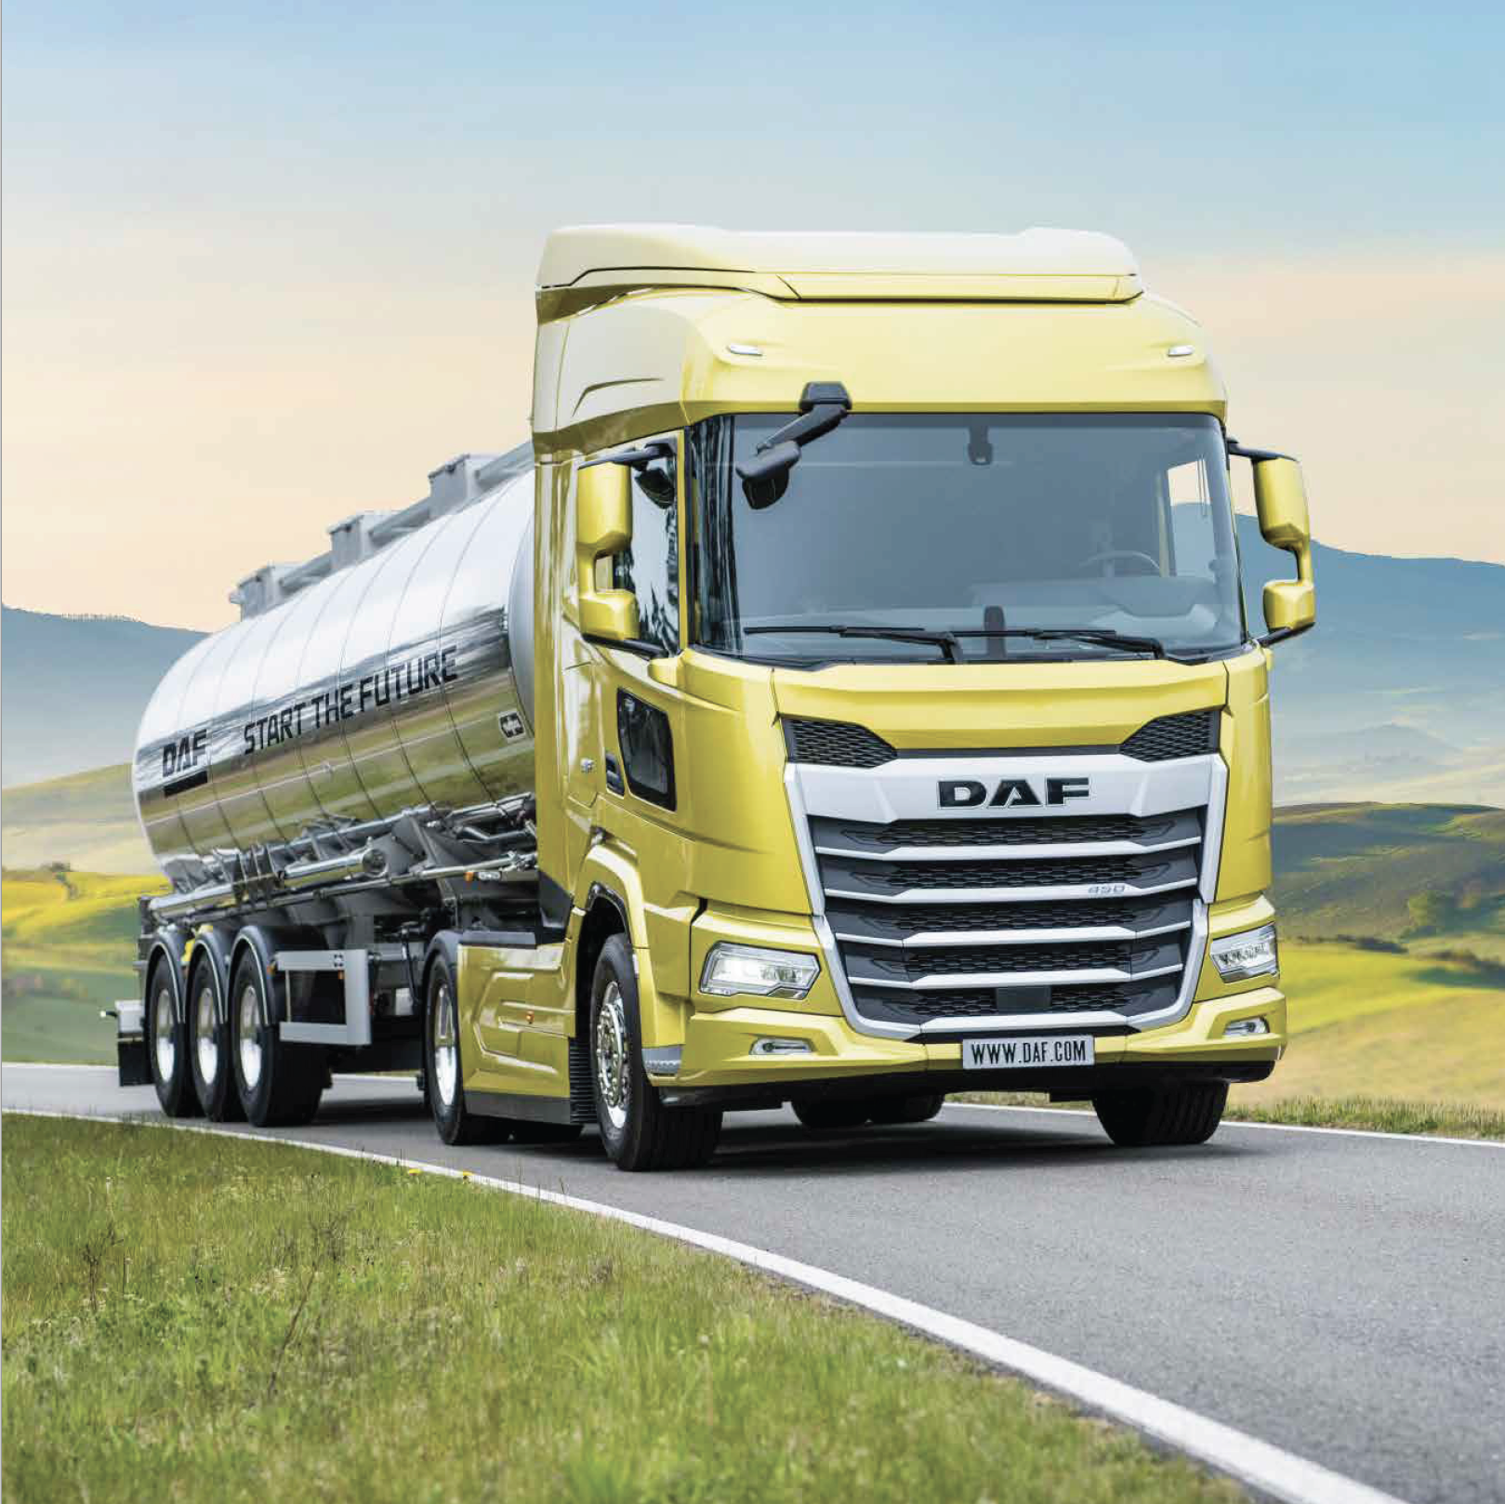
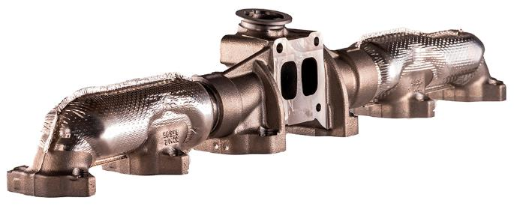
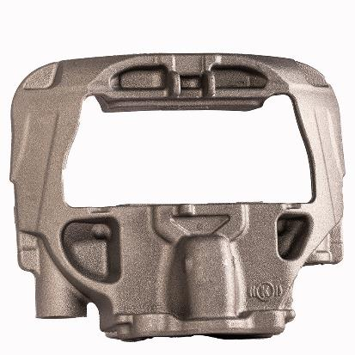
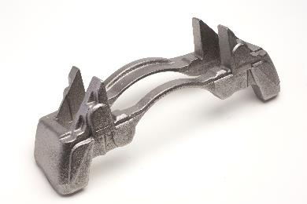
Castings for Commercial Vehicles

Slide 7
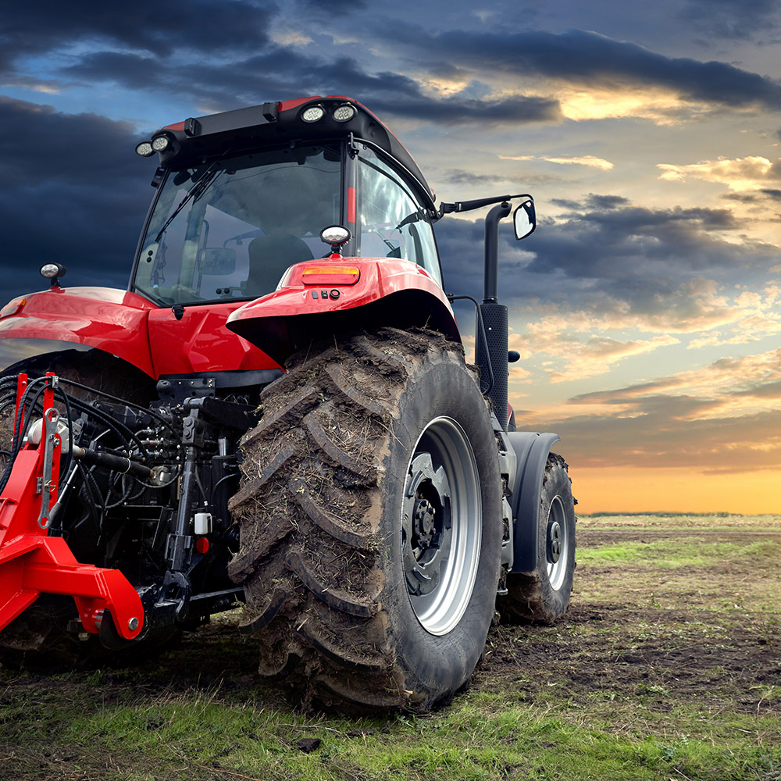
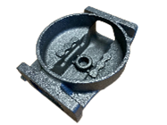
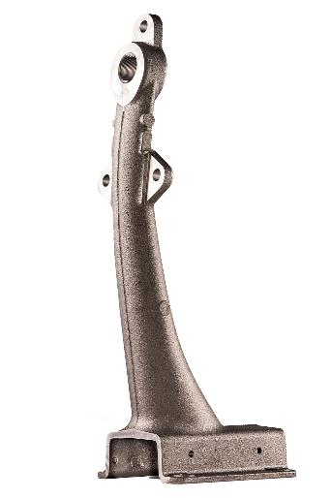
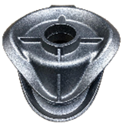
Castings for Agricultural Application

Slide 8
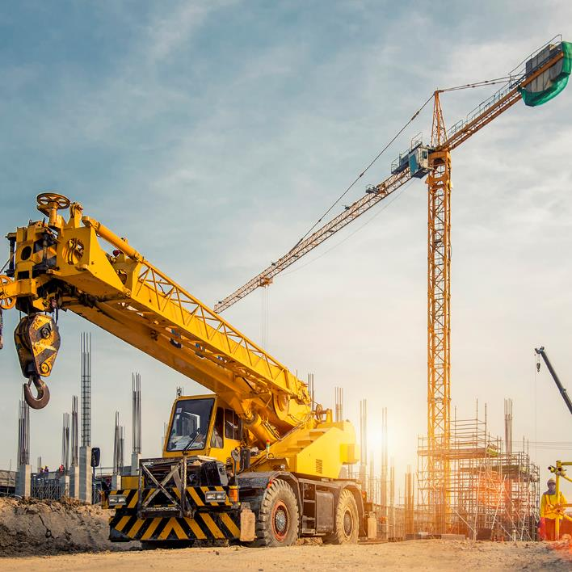
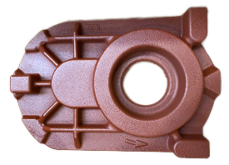
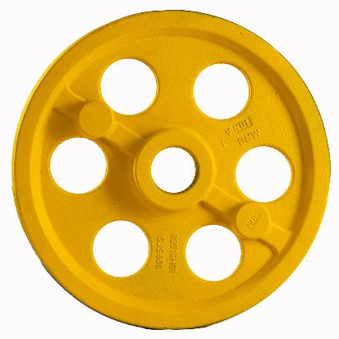
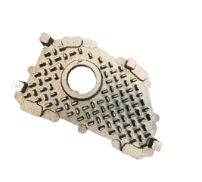
Castings for Industrial Applications

Slide 9
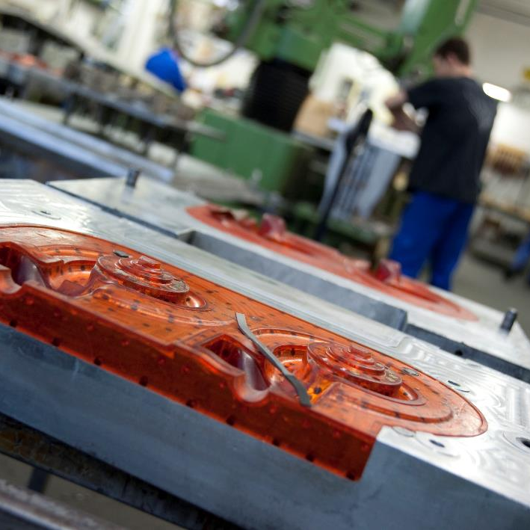
Inhouse model shop including 3D-design
  3D design and simulation
  3 CNC milling machines
  3D printer for visual samples
  Serial tools out of resin or steel
  Manufacturing inhouse and with external partners
  Model shop employees with high experience

Slide 10
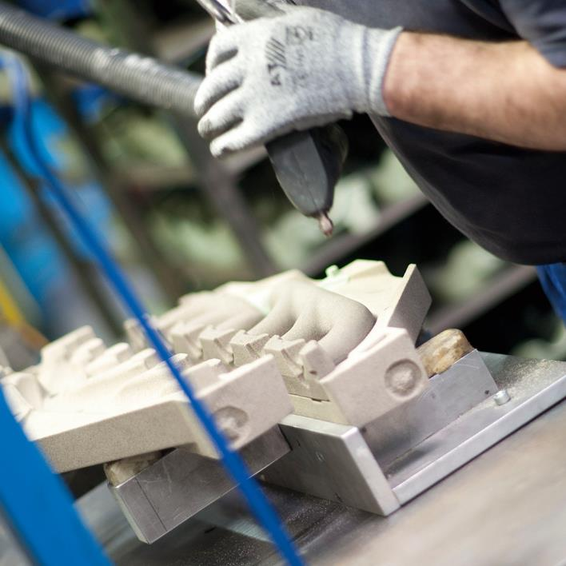
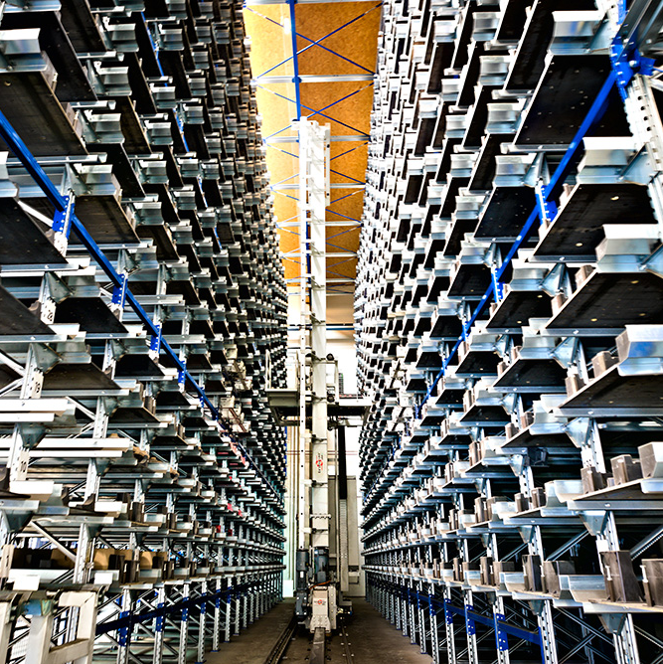
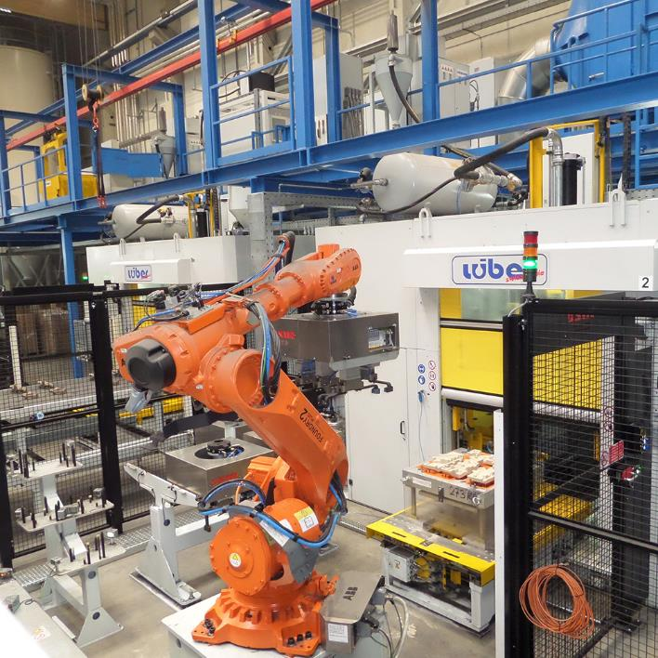
Coreshop
  9 Core shooting machines 20, 25 and 40 l
  Coldbox process
  Manual handling
  Semi and full automatic handling
  Automatic warehouse

Slide 11
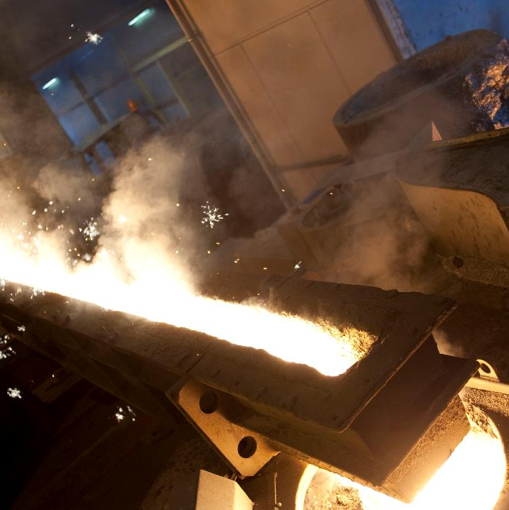
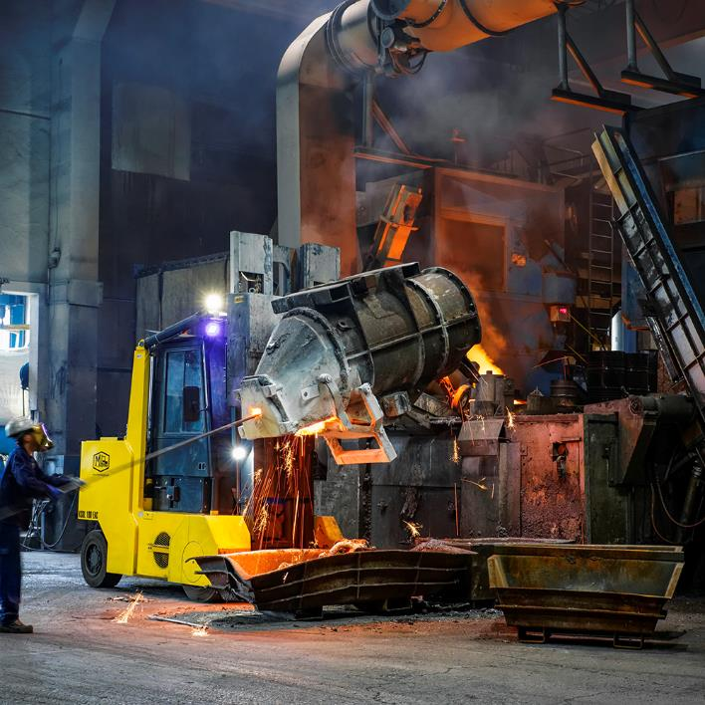
Melting department
  Melting output: 12-14 t/h
  2 medium frequency furnaces 8 tons in tandem operation
  1 holding furnace 8 tons
  Magnesium treatment with GF converter process

Slide 12
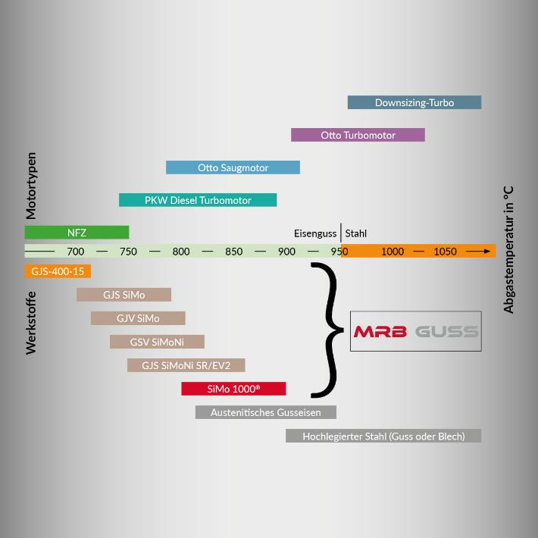
Materials
  Gray iron
    GJL 200 - 300
  Ductile iron
    GJS 400 - 850
  High temperature application
    GJS/GJV SiMo , GJS/GJV SiMoNi, GJS SiMo 1000
  Development of customized material properties

Slide 13

Werkstoffe
  Gray iron
    GJL 200 - 300
  Ductile iron
    GJS 400 - 850
  High temperature application
    GJS/GJV SiMo , GJS/GJV SiMoNi, GJS SiMo 1000
  Development of customized material properties

Slide 14
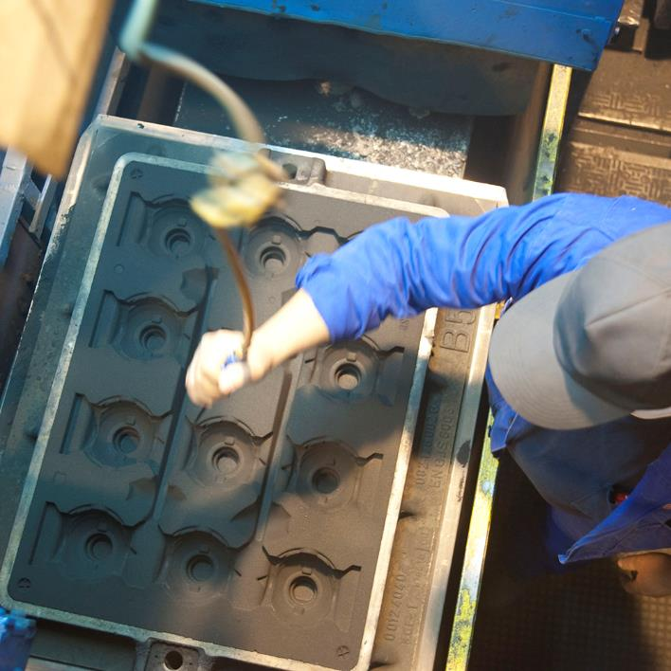
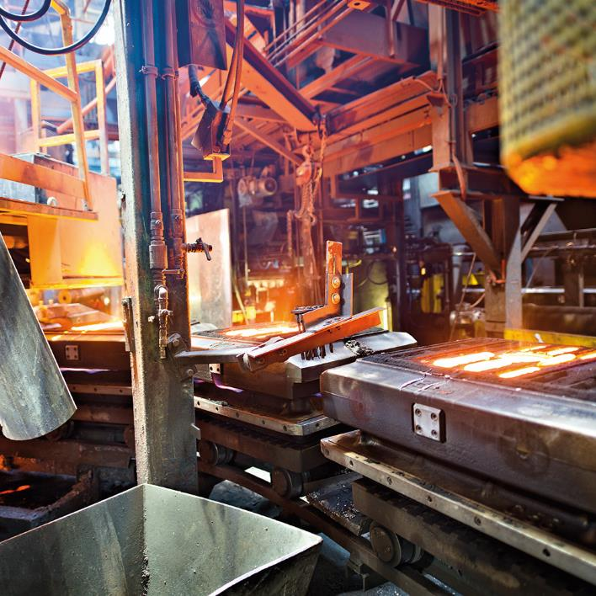
Moulding line
  Horizontal Hansberg greensand system
  Mould dimensions 760 x 560 x 180/190 mm
  220 moulds per hour – 15 sec per mould
  Various options of core setting :
    Manually in sand mould
    Manually precentered and inserted by robot
    Direct from warehouse
  Two casting furnaces
  Automatic pouring system and inoculation control

Slide 15
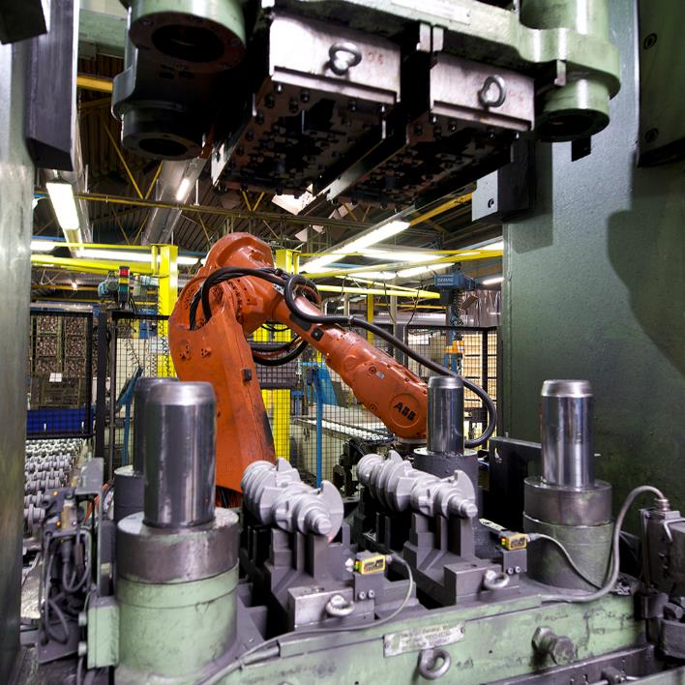
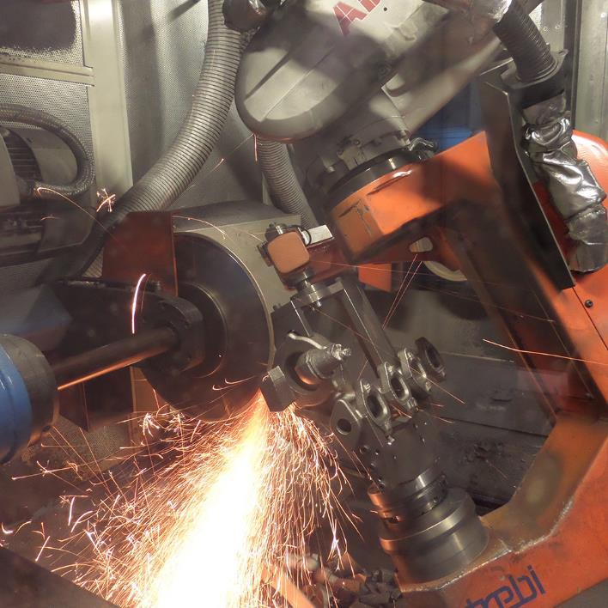
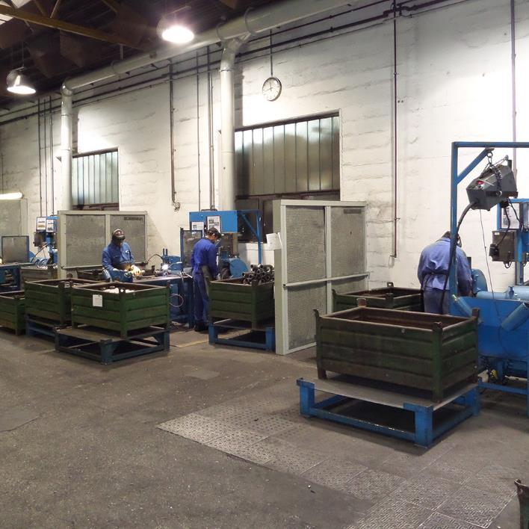
Finishing department
  Manual deburring work places
  Automated cutting and grinding cells with robot
  Automated punching deburring cells
  Integrated thermography test for crack detection and endoscopy
  Primer coating/painting inhouse

Slide 16
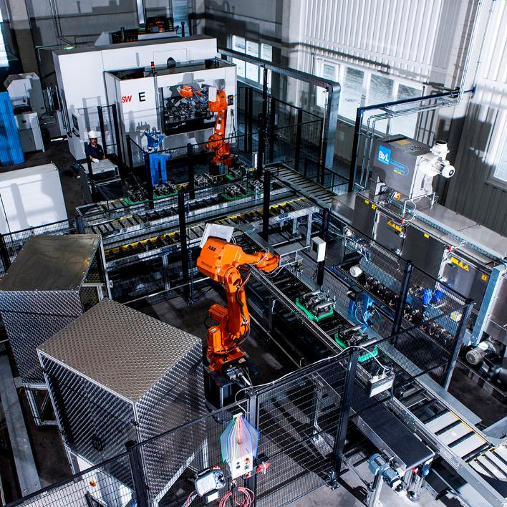
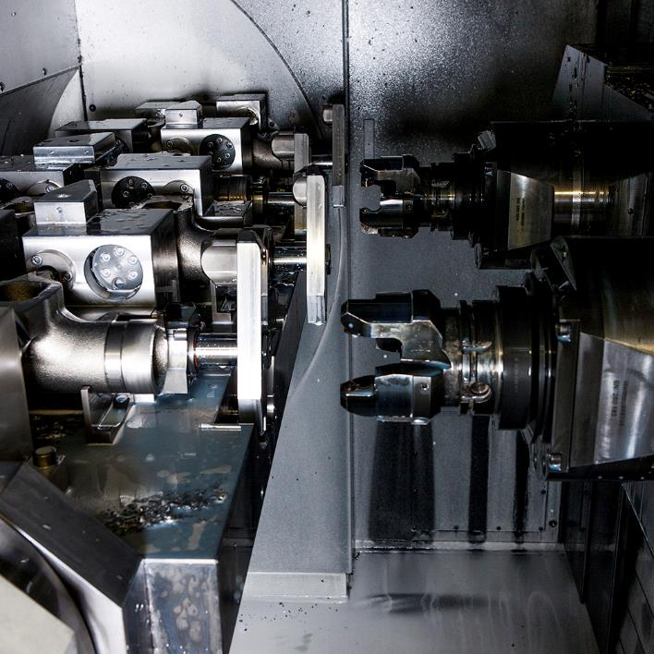
Machining Department
  10 CNC machining centers 4 axis
    SW BA600, SW BA422
    Manual or automatic loading
  4 CNC machining centers 5 axis
    Mikron, Hermle
  1 CNC turning machine (Emag)
  Automatic palletizing of castings from box by robot camera system
  Washing, leak test, welding and assembly
  DMC via laser or stamping

Slide 17
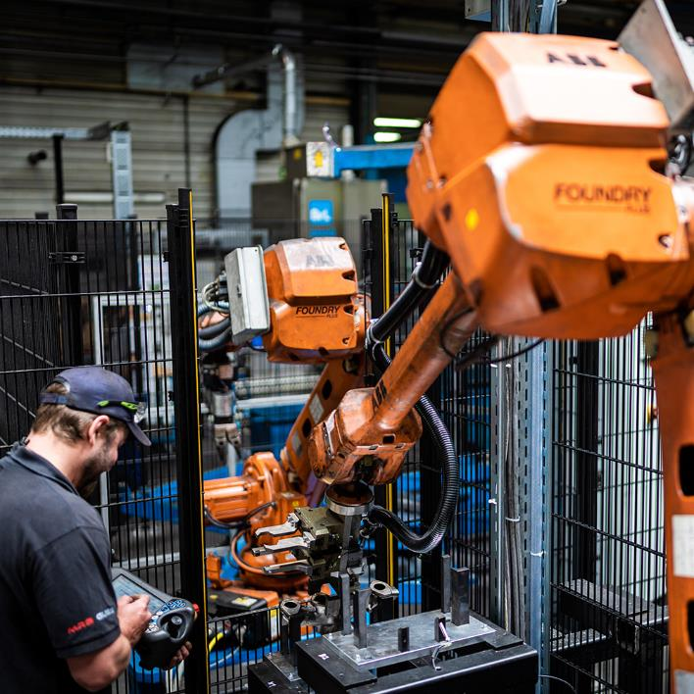
Inhouse Automation Department
  Automation of existing units
  Automation of new units
  Electrics, mechanics and programming
  Planning, design, set-up and implementation
  Optimization of processes and cycle time
  Increase of OEE by shift operation according to production

Slide 18
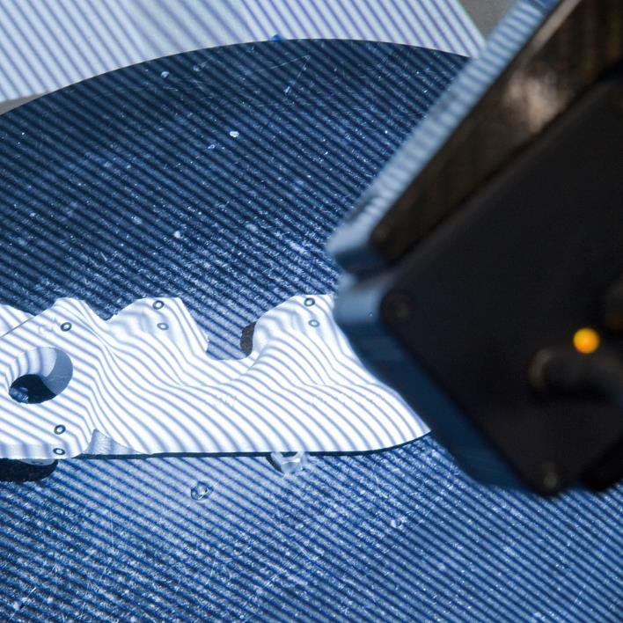
Quality Equipment
  3D-GOM ATOS Digitizer for measuring
  Zeiss measuring machines
  Separate washing system for technical cleanliness analysis
  Automatic gauging tool
  CT X-ray system Zeiss / Bosello 450 KV
  Ultrasonic test
  Porosity cutting

Slide 19
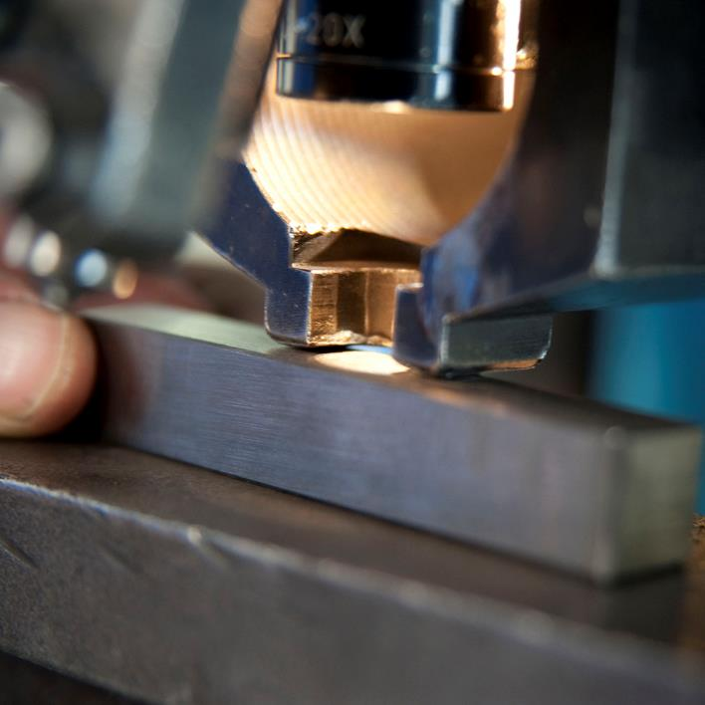
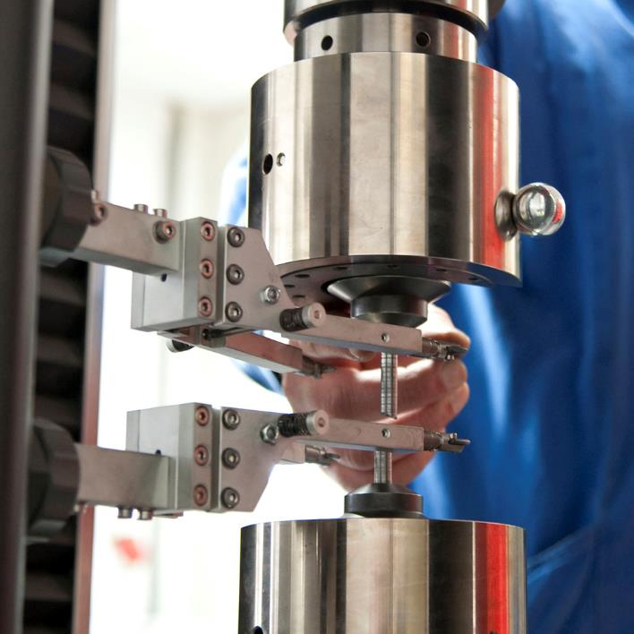
Laboratory equipment
  Leco carbon content determination
  Tensile test
  Microstructure analysis
  Brinell hardness testing
  Spectral analysis device OBLF
  Sand lab for all sand values

Slide 20
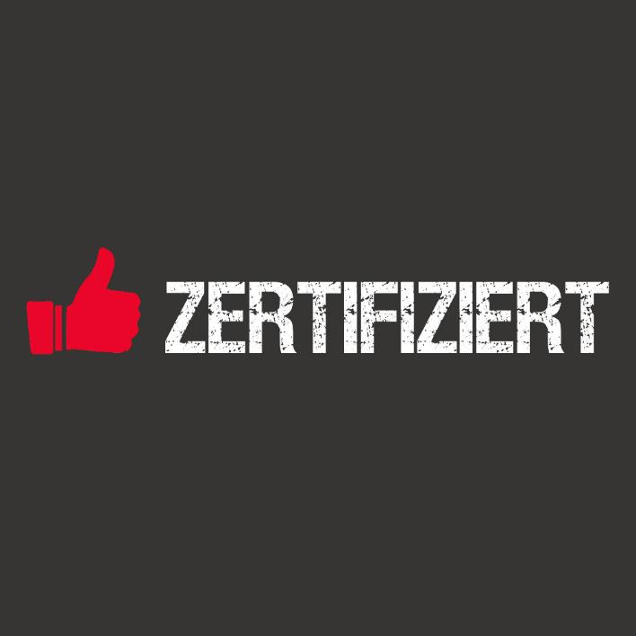
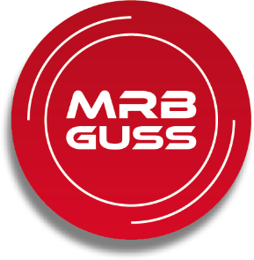
Certifications
Integrated Management System
  Quality Management Systems ISO 9001:2015
  Environmental Management Systems ISO 14001:2015
  OH&S-Management Systems ISO 45001:2018

Slide 21







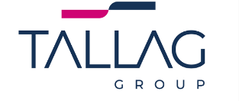



















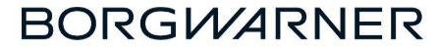







References

